Slide 1
Linux- Introduction

Slide 2
What is Linux?
Linux is a freely distributed version of a UNIX-like kernel, developed by Linus Torvalds at the University of Helsinki.
The intention is that the Linux kernel will not incorporate proprietary code but will contain nothing but freely distributable code.
Open-source software (OSS)- A type of computer software whose source code is released under a license in which the copyright holder grants users the rights to study, change, and distribute the software to anyone and for any purpose.
Open-source software may be developed in a collaborative public manner between multiple independent contributors..

Slide 3
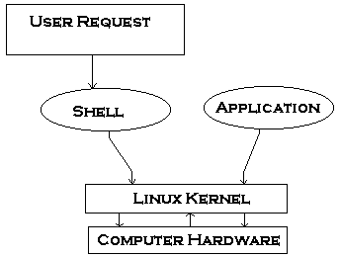
Kernel
A kernel is the central part of an operating system. It manages the operations of the computer and the hardware - most notably memory and CPU time. In other words it manages the system resources and the communication among the hardware and other system services.

Slide 4
Features of the kernel
Process management
File management
Multitasking or multithreaded capability
Inter Task communication facilities
Resource (ex. Memory) management mechanism
Interrupt handling mechanism

Slide 5
Booting Linux OS
The embedded Linux kernel image is stored in flash memory in compressed format.
When the target is powered up, a small bootloader residing at the base of flash memory begins execution.
The bootloader copies the compressed kernel image from flash memory to RAM.

Slide 6
Booting Linux OS
It then transfers control to an address at the beginning of kernel image.
The kernel then un-compresses itself and boots up the target.

Slide 7
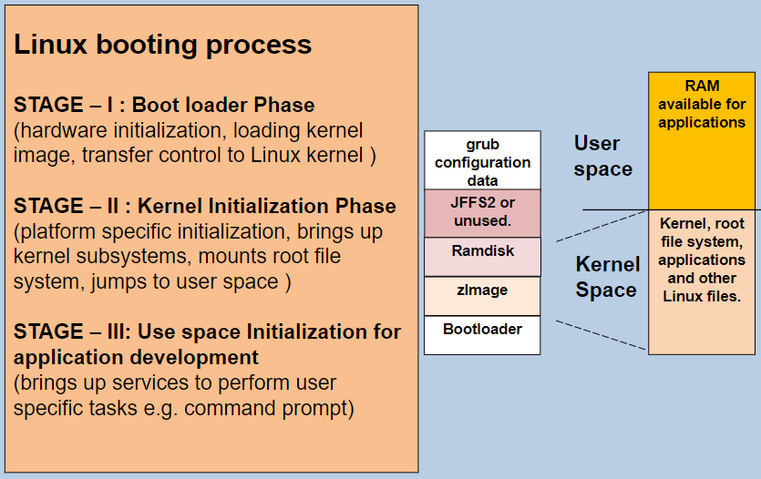
Linux Boot Process

Slide 8
Linux Binary Images
Minimum 2 binary images are required to be downloaded on the embedded Linux target, viz., zImage and ramdisk.gz
zImage is the compressed Linux kernel image, which mainly includes all the device drivers compiled for the specific target.
ramdisk.gz will contain the compressed image of root file system. It is the file system that will be present on the board after booting. The initial ramdisk file system is present in the system RAM.
This file system will contain the files that were copied when the initial ramdisk image was created during the build process.
Refer: https://www.ibm.com/developerworks/library/l-linuxboot/index.html

Slide 9
Linux file system
Directory | Content
/bin | Common programs, shared by the system, the system administrator and the users.
/boot | The startup files and the kernel, vmlinuz. In some recent distributions also grub data. Grub is the GRand Unified Boot loader.
/dev | Contains references to all the CPU peripheral hardware, which are represented as files with special properties.
/etc | Most important system configuration files are in /etc, this directory contains data similar to those in the Control Panel in Windows
/home | Home directories of the common users.
/initrd | (on some distributions) Information for booting. Do not remove!
/lib | Library files, includes files for all kinds of programs needed by the system and the users.
/lost+found | Every partition has a lost+found in its upper directory. Files that were saved during failures are here.

Slide 10
Linux file system
/misc | For miscellaneous purposes.
/mnt | Standard mount point for external file systems, e.g. a CD-ROM or a digital camera.
/net | Standard mount point for entire remote file systems
/opt | Typically contains extra and third party software.
/proc | A virtual file system containing information about system resources. More information about the meaning of the files in proc is obtained by entering the command man proc in a terminal window. The file proc.txt discusses the virtual file system in detail.
/root | The administrative user's home directory. Mind the difference between /, the root directory and /root, the home directory of the root user.
/sbin | Programs for use by the system and the system administrator.
/tmp | Temporary space for use by the system, cleaned upon reboot, so don't use this for saving any work!
/usr | Programs, libraries, documentation etc. for all user-related programs.

Slide 11
Basic Commands in Linux

Slide 12
ls command
Lists the files in the current directory, in alphanumeric order, except files starting with the “.” character
ls -a (all) Lists all the files (including .* files) | ls -S (size) Lists the biggest files first
ls -l (long) Long listing (type, date, size, owner, permissions) | ls -r (reverse) Reverses the sort order
ls -t (time) Lists the most recent files first | ls -ltr (options can be combined) Long listing, most recent files at the end

Slide 13
File name pattern substitutions
Practice following commands
ls *txt The shell first replaces *txt by all the file and directory names ending by txt (including .txt), except those starting with ., and then executes the ls command line.
ls -d .* Lists all the files and directories starting with . -d tells ls not to display the contents of directories.
cat ?.log Displays all the files which names start by 1 character and end by
.log

Slide 14
The cd and pwd commands
cd <dir> Changes the current directory to <dir>.
cd - Gets back to the previous current directory.
pwd Displays the current directory ("working directory").

Slide 15
The cp command
cp <source_file> <target_file> Copies the source file to the target.
cp file1 file2 file3 ... dir Copies the files to the target directory (last argument).
cp -i (interactive) Asks for user confirmation if the target file already exists
cp -r <source_dir> <target_dir> (recursive) Copies the whole directory.

Slide 16
mv and rm commands
mv <old_name> <new_name> (move) move the given file or directory.
mv -i (interactive) If the new file already exits, asks for user confirm
rm file1 file2 file3 ... (remove) Removes the given files.
rm -i (interactive) Always ask for user confirm.
rm -r dir1 dir2 dir3 (recursive) Removes the given directories with all their contents.

Slide 17
Creating and removing directories
mkdir dir1 dir2 dir3 ... (make dir) Creates directories with the given names.
rmdir dir1 dir2 dir3 ... (remove dir) Removes the given directories Safe: only works when directories and empty. Alternative: rm -r (doesn't need empty directories).

Slide 18
Displaying file contents
Several ways of displaying the contents of files.
cat file1 file2 file3 ... (concatenate) Concatenates and outputs the contents of the given files.
more file1 file2 file3 ... After each page, asks the user to hit a key to continue. Can also jump to the first occurrence of a keyword (/ command).
less file1 file2 file3 ... Does more than more with less. Doesn't read the whole file before starting. Supports backward movement in the file (? command).

Slide 19
File access rights
Use ls -l to check file access rights
3 types of access rights:
Read access (r)
Write access (w)
Execute rights (x)
3 types of access levels
User (u): for the owner of the file Group (g): each file also has a “group” attribute, corresponding to a given list of users Others (o): for all other users

Slide 20
Access right constraints
x is sufficient to execute binaries Both x and r and required for shell scripts.
Both r and x permissions needed in practice for directories: r to list the contents, x to access the contents.
You can't rename, remove, copy files in a directory if you don't have w access to this directory.
If you have w access to a directory, you CAN remove a file even if you don't have write access to this file (remember that a directory is just a file describing a list of files). This even lets you modify (remove + recreate) a file even without w access to it.

Slide 21
Access right examples
-rw-r--r-- Readable and writable for file owner, only readable for others
-rw-r----- Readable and writable for file owner, only readable for users belonging to the file group.
drwx------ Directory only accessible by its owner
-------r-x File executable by others but neither by your friends nor by yourself. Nice protections for a trap...

Slide 22
chmod: changing permissions
chmod <permissions> <files> 2 formats for permissions:
Octal format (abc): a,b,c = r*4+w*2+x*1 (r, w, x: booleans)
Example: chmod 644 <file> (rw for u, r for g and o)
symbolic format. Easy to understand by examples: chmod go+r: add read permissions to group and others. chmod u-w: remove write permissions from user. chmod a-x: (a: all) remove execute permission from all.

Slide 23
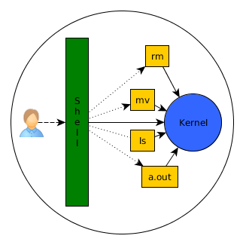
What is a shell?
Shell is a program, which accepts our instructions and commands and passes them to the kernel.
- Shell is a command language interpreter that executes commands read from the standard input device (keyboard) or any file.
- Shell is not a part of system kernel, but uses the kernel to execute programs.
- cat /etc/shells command will give the various shells in our system.
- Shell types: Bourne, Bash, csh, tcsh, Ksh, etc.

Slide 24
Why program with Shell?
You can program the shell quickly and simply.
Shell is always available on most basic Linux installation
Shell is ideal for simple tasks where efficiency is less important than easy configuration, maintenance & portability.
In shell, commands run in a predetermined sequence.
The shell executes shell scripts, which are interpreted at run-time.
Shell helps to automate some task of day today life.
These scripts makes debugging easier.

Slide 25
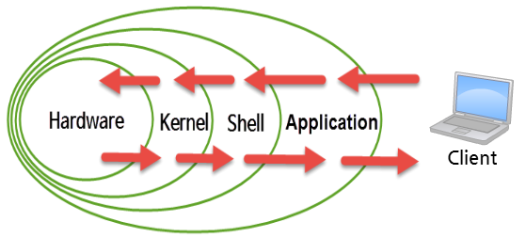
Stages- User to Hardware

Slide 26
Shell Script
Normally shells are interactive but if you can store this sequence of command to text file and tell the shell to execute this text file instead of entering the commands.
This is know as shell script.
To make a script executable, you can run it in two ways:
1. Invoke the shell with the name of the script file as parameter:
ex: # /bin/sh first.sh
2. Change the file mode to make the file executable for all users using the chmod command and then execute:
ex: # chmod +x first.sh
# ./first.sh

Slide 27
Shell script examples
Write a shell script that asks for a valid password as input. If given password matches to secret password stored internally, then only it allows the access.
#!/bin/sh
# This is some secure program that uses security.
VALID_PASSWORD="secret"
echo "Please enter the password:"
read PASSWORD
if [ "$PASSWORD" == "$VALID_PASSWORD" ]; then
echo "You have access!"
else
echo "ACCESS DENIED!“
fi

Slide 28
Shell script examples (contd.)
Write a Shell script that will check for certain age ranges. If you are less than 20 or greater than 50, you are out of the age range. If you are between 20 and 30 you are in your 20's and so on.
#!/bin/sh
# Prompt for a user name...
echo "Please enter your age:"
read AGE
if [ "$AGE" -lt 20 ] || [ "$AGE" -ge 50 ]; then
echo "Sorry, you are out of the age range."
elif [ "$AGE" -ge 20 ] && [ "$AGE" -lt 30 ]; then
echo "You are in your 20s"
elif [ "$AGE" -ge 30 ] && [ "$AGE" -lt 40 ]; then
echo "You are in your 30s"
elif [ "$AGE" -ge 40 ] && [ "$AGE" -lt 50 ]; then
echo "You are in your 40s"
fi

Slide 29
Shell script examples (contd.)
Write a script say, Hello to print Good Morning Good Afternoon Good Evening , according to system time.
temph=`date | cut -c12-13`
dat=`date +"%A %d in %B of %Y (%r)"`
if [ $temph -lt 12 ]
then
mess="Good Morning $LOGNAME, Have nice day!"
fi
if [ $temph -gt 12 -a $temph -le 16 ]
then
mess="Good Afternoon $LOGNAME"
fi
if [ $temph -gt 16 -a $temph -le 18 ]
then
mess="Good Evening $LOGNAME"
fi

Slide 30
Shell script examples (contd.)
Write Script, using case statement to perform basic math operation as follows
+ addition
- subtraction
x multiplication
/ division
The name of script must be 'q4' which works as follows
$ ./q4 20/3, Also check for sufficient command line arguments
if test $# = 3 # no. of parameters passed
then
case $2 in
+) let z=$1+$3;;
-) let z=$1-$3;;
/) let z=$1/$3;;
x|X) let z=$1*$3;;
*) echo Warning - $2 invalid operator, only +,-,x,/ operator allowed
exit;;
esac
echo Answer is $z
else
echo "Usage - $0 value1 operator value2"
echo " Where, value1 and value2 are numeric values"
echo " operator can only be +,-,/,x"
fi

Slide 31

Please contact
Foundation for Innovation and Collaborative
Education
mentor@fice.in
www.fice.in
Please contact
Foundation for Innovation and Collaborative
Education
info@fice.in
mentor@fice.in
Notes:
Here are the lessons we are going to learn today.

